Slide 1

Group 2 – Theme 3 Design Project – Presentation
Arnob Gosh – 103494114 Alexandre Cluzet – 105318766 Jacob F. Larsen – 105323472 Nick Watson – 103600076 Nguyen Tran – 103844463

Slide 2
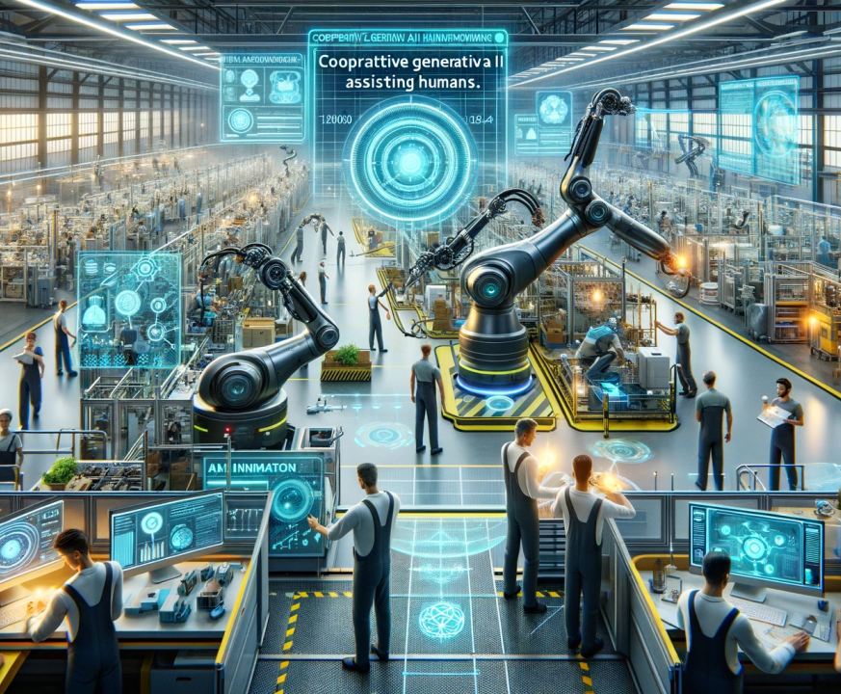
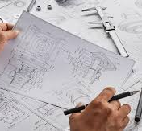
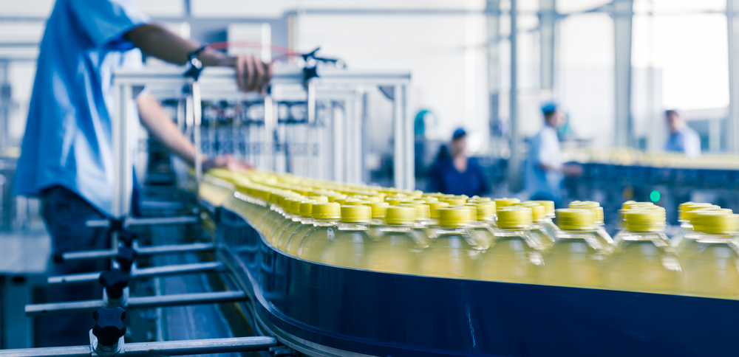
Mechanical Engineer
Product manufacturing
Potential into the Future
High Adaptation
High Quality
Improve Efficiency
Long-term Sustainability
Optimized Product chain
Reduce Waste

Slide 3
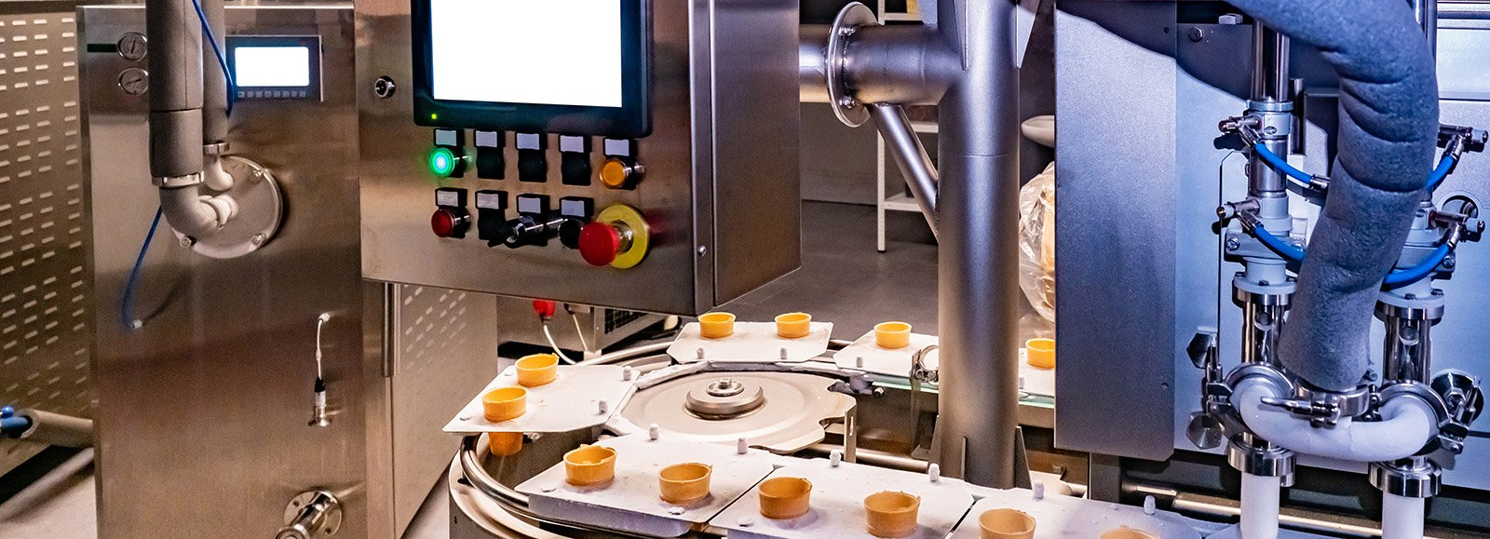

Application
Quality Control in Food and Beverage Production
Automated Production Line Tuning
Supply Chain Optimization Using Production Data
Environmental Monitoring and Compliance

Slide 4
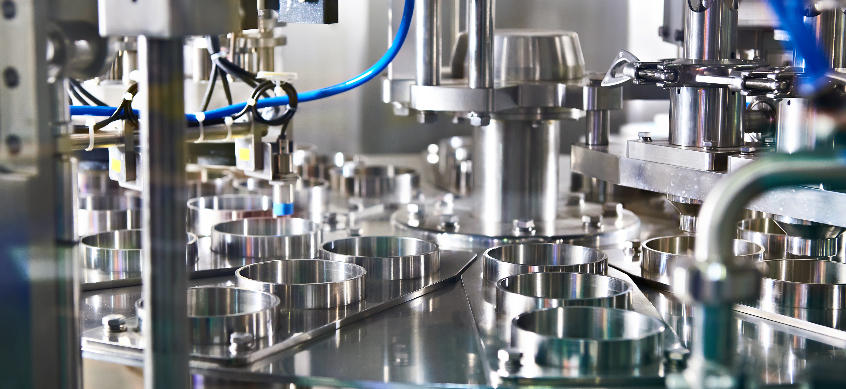
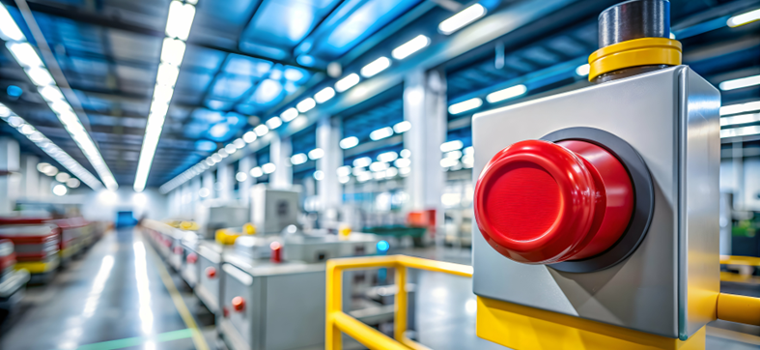
Snapshot of the Dataset
The data for this project has been derived from a combination of sensor readings and machine settings during the processing and production of Vegemite
This data has been differentiated into multiple .csv files based on the consistency of the final product, labelled as "good", "low bad" and "high bad"
Significant data cleaning and pre-processing is required for this data to be effective in machine learning models, due to a high volume of duplicate data and poor class distribution
The dataset also contains an information log of shutdowns across a two-month period in another folder named "Downtime"
Once a machine learning model has been developed, this data will be used to predict shutdown events ahead of time based on readings gathered from the system

Slide 5
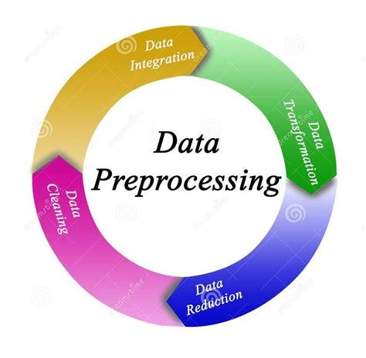
Data Preprocessing Workflow
Data Cleaning
Removed duplicates for data integrity
Handled missing values to improve data quality
Balanced classes to ensure fair representation
Exploratory Data Analysis (EDA)
Analyzed trends and correlations with machine settings
Detected and addressed outliers to enhance accuracy
Used visualizations (histograms, heatmaps) for insights
Feature Engineering
Selected key features affecting product quality
Created new features for improved model insights
Applied normalization and scaling for consistency
Outcome
Prepared a structured, balanced dataset
Enhanced dataset readiness for machine learning

Slide 6
Week | Weekly Achievement
9 | Project Training and Development | Data Labelling
10 | Project Finalise/ Presentation Preparation | Data Pre-processing
11 | Presentation | Model Development / Expectation
12 | Project Demo / Report Preparation | Final Model
Workflow

Slide 7

Expectation
Reduce production waste
Lower energy consumption
Anomaly Detection
Recommendations for Production Settings

